Slide 1
Comparative Analysis of the Natural History and Outcomes of Early-Onset and Late-Onset Colorectal Cancer
Presented by Linnea Schumann on behalf of the IDEAL4OMOP colorectal cancer study team
27th November 2024

Slide 2
Study team: bringing together our expertise
Contributors | Project Role | Center
Ana Catarina Rodrigues | Clinician | Porto
Audrius Dulskas | Clinician | Vilnius
Danielle Newby | Data analytics | Oxford
Linnea Schumann | Data analytics | Frankfurt
Ping Wu | Data analytics | London
Rita Ribeiro da Silva | Clinician | Porto
Yomi Okegunna | Clinician | Maastricht

Slide 3
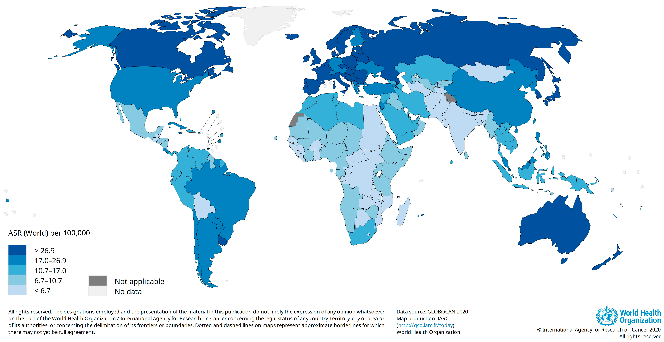
Epidemiology of CRC
The increasing incidence of colorectal cancer (CRC) impacts both high-income and low- and middle-income countries.¹
Accounts for approximately 10% of all new cancer cases worldwide.²
Ranks as the 2nd leading cause of cancer-related mortality.²
CRC patients have a heightened risk of sepsis, especially post-surgery, due to increased vulnerability and infection rates.³
Figure 1. Estimated age-standardized incidence rate for colorectal cancer, 2020

Slide 4
Epidemiology of EOCRC
Early-onset CRC (EOCRC), diagnosed in individuals under 50 years, is rapidly increasing.⁴
EOCRC is characterized by distinct clinicopathological features, unique molecular characteristics and a potentially worse prognosis compared to LOCRC.⁵
10%
About 10% of CRCs appear in people under age 50.
2030
EOCRC could be the deadliest cancer by 2030 in people aged <50.
51%
Since 1994, cases of EOCRC have increased by 51 percent.
Rectal
Rectal cancer is more common than colon cancer in young patients.
45
The age people at average risk should start getting checked.
Delays
Delays in diagnosis occur in 15-50% of early-onset cases.
Figure 2: Epidemiological Trends of EOCRC

Slide 5
Current Problems in Early-Onset & Late-Onset Colorectal Cancer Research
Rise in EOCRC incidence, but a lack of large-scale studies focusing on it.
Knowledge gaps remain regarding the comparative survival outcomes, treatment patterns, and clinical characteristics of EOCRC and LOCRC.
Figure 3: Colorectal Cancer Statistics 2023

Slide 6
Research Question and Objectives
Primary objective: How do patient and clinical characteristics differ between early-onset and late-onset colorectal cancer, and what impact do these differences have on treatment patterns and survival outcomes?
Secondary objective: What is the incidence of sepsis in early-onset versus late-onset colorectal cancer patients, and how does sepsis influence treatment responses and overall patient prognosis?

Slide 7
Study Design
Retrospective observational database study using the OMOP Common Data Model (CDM)⁶
Research questions were created to align with the MEDOC items⁷
Figure 4: MEDOC-Items

Slide 8
Inclusion and Exclusion Criteria
Table 1: Inclusion and Exclusion Criteria
Inclusion | Exclusion
Age: ≥18 EOCRC: <50 LOCRC: ≥50 | Age: <18
Diagnosis: Between January 1st 2014 and December 31st 2023 At one of the 5 partner centers Histologically confirmed CRC diagnosis | Diagnosis: Outside the defined time window Diagosed in other centers Prior cancer diagnosis Palliative cases
Data: Complete data available Follow-up for at least 12 months | Data: Incomplete data Follow-up shorter than 12 months
Secondary Analysis: Occurrence of sepsis | Secondary Analysis: Absence of sepsis

Slide 9
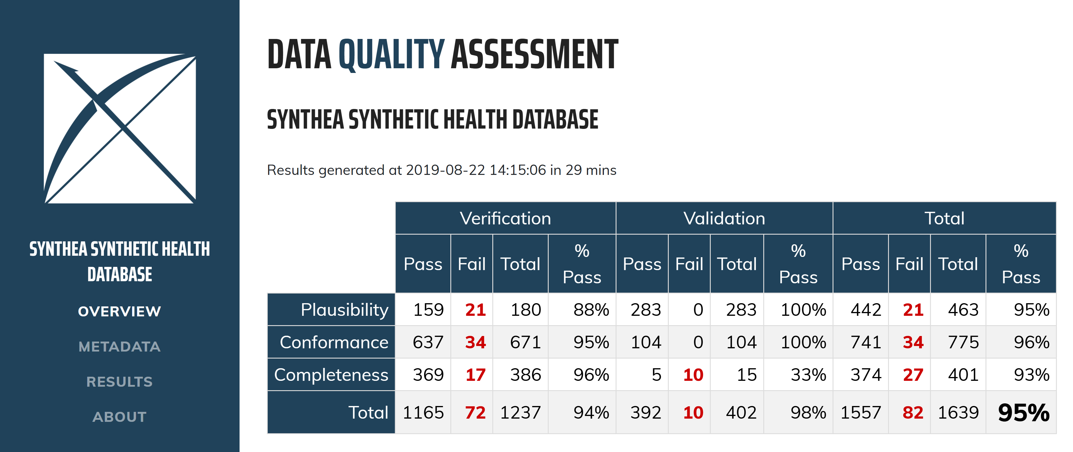
Data Analyses
All analyses will use established R packages and OHDSI tools on databases standardized to the OMOP CDM, enabling a federated data analysis using Vantage6.
The code will be made available on GitHub to ensure reproducibility and transparency.
Quality control
Every center is responsible for their data quality
Implementation of OHDSI quality control tools
Figure 5: Data Analysis Tools

Slide 10
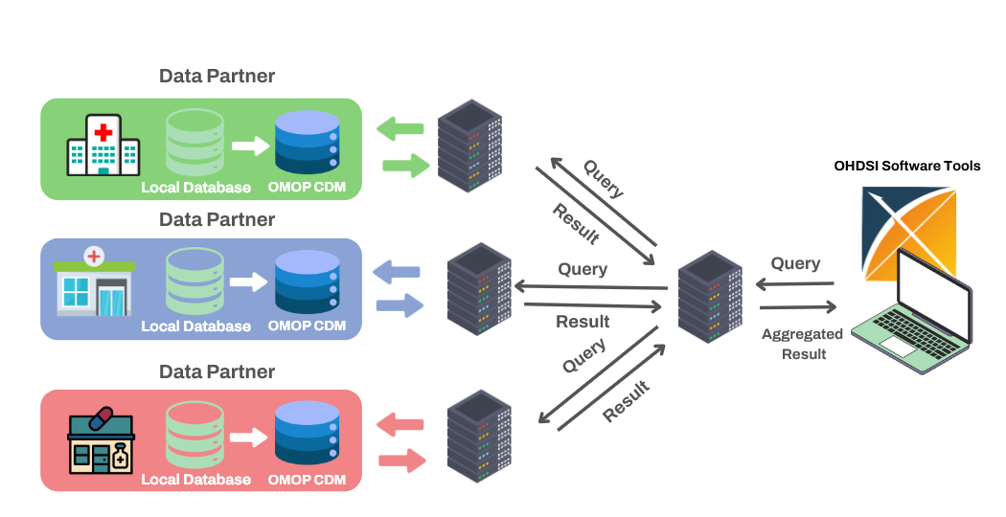
Data Analyses
1. Phenotyping of CRC: Definition and validation of clinical phenotypes for EOCRC and LOCRC
Comprehensive description of epidemiological data, diagnostic criteria, disease characteristics, and treatment patterns
Codelist development and validation
2. Characterization of Demographics, Comorbidities, and Medication Use
Characterization and comparison of demographics, comorbidities (sepsis), and medication usage between EOCRC and LOCRC populations.
Temporal trends
Sepsis occurrence
Figure 6: Federated Data Analysis Using OMOP

Slide 11
Data Analyses
3. Survival Analysis of EOCRC and LOCRC
Estimation and comparison of survival outcomes for EOCRC and LOCRC patients to assess differences in prognosis.
Survival analysis with the Kaplan-Meier (KM) method and Cox proportional hazards ratio:
Overall survival (OS)
Progression-free survival (PFS)
Survival rates at one, five, and ten years post-diagnosis
Stratification by: EOCRC vs. LOCRC, center, age group, sex, disease stage, treatment type
Figure 6: Federated Data Analysis Using OMOP

Slide 12
Study Timeline
Comparative Analysis of the Natural History and Outcomes of Early-Onset and Late-Onset Colorectal Cancer

Slide 13
Future Work Potential
Inclusion of further data partners
Acquisition of additional funding
Expansion of research objectives

Slide 14
Thank you!
Presented by Linnea Schumann on behalf of the IDEAL4OMOP colorectal cancer study team
27th November 2024

Slide 15
References
Schliemann, D., Ramanathan, K., Matovu, N., O’Neill, C., Kee, F., Su, T. T., & Donnelly, M. (2021). The implementation of colorectal cancer screening interventions in low-and middle-income countries: a scoping review. BMC Cancer, 21(1), 1125. https://doi.org/10.1186/s12885-021-08809-1.
Colorectal cancer. (n.d.). Who.int. Retrieved November 21, 2024, from https://www.who.int/news-room/fact-sheets/detail/colorectal-cancer.
Han, C., Chen, W., Ye, X.-L., Cheng, F., Wang, X.-Y., Liu, A.-B., Mu, Z.-H., Jin, X.-J., & Weng, Y.-H. (2023). Risk factors analysis of surgical site infections in postoperative colorectal cancer: a nine-year retrospective study. BMC Surgery, 23(1), 320. https://doi.org/10.1186/s12893-023-02231-z.
Saad El Din, K., Loree, J. M., Sayre, E. C., Gill, S., Brown, C. J., Dau, H., & De Vera, M. A. (2020). Trends in the epidemiology of young-onset colorectal cancer: a worldwide systematic review. BMC Cancer, 20(1), 288. https://doi.org/10.1186/s12885-020-06766-9.
Lawler, T., Parlato, L., & Warren Andersen, S. (2024). The histological and molecular characteristics of early-onset colorectal cancer: a systematic review and meta-analysis. Frontiers in Oncology, 14, 1349572. https://doi.org/10.3389/fonc.2024.1349572.
Data standardization – OHDSI. (n.d.). Ohdsi.org. Retrieved November 21, 2024, from https://www.ohdsi.org/data-standardization/.
Mahon, P., Chatzitheofilou, I., Dekker, A., Fernández, X., Hall, G., Helland, A., Traverso, A., Van Marcke, C., Vehreschild, J., Ciliberto, G., & Tonon, G. (2024). A federated learning system for precision oncology in Europe: DigiONE. Nature Medicine, 30(2), 334–337. https://doi.org/10.1038/s41591-023-02715-8.

